Slide 1


MediGenius AI:Fracture Recovery Revolutionized Using AI
Group members ID
1.Ashrin Mobashira Shifa 1922216642
2.Rokaeya Sharmin 1911993042
3.MD.Khurshid Jahan 1922079042

Slide 2
What is the project?
1. Project Overview:
- Developed an AI-powered system employing advanced image processing and deep learning to accurately identify
fractures. Integrated natural language processing for personalized patient recommendations, revolutionizing fracture
diagnosis and treatment.
2. Functionality:
- Analyzes fracture images to accurately identify the type and severity of fractures.
- Generates personalized suggestions and advice for patients based on the diagnosis.
3. Benefits:
- Enables swift and accurate fracture diagnosis, aiding healthcare professionals in treatment planning.
- Provides patients with tailored recommendations, enhancing their recovery process.
4. Impact:
- Significantly improves the efficiency of fracture diagnosis and treatment, leading to better patient outcomes.

Slide 3
Analysis of the design
01
02
Problems
Our product
03
04
05
Rersources
Innovation
Algorithms
Integration of AI and Medical Expertise
Textual representation of Fracture Description and doctors Suggestion
Unique Dataset Creation as image and nlp data.
Natural Language Processing (NLP) for Medical Insights
Feature Extraction with ResNet-50 and VGG16 and Sequence Generation with LSTM

Slide 4
Usability, Manufacturability, Sustainability
Usability:
1. Help Doctors to evaluate with a second opinion.
2. This technology will be really helpful if doctor is not available it will give the immediate course of action to a patient.
3. It will be also helpful for student of medical in the study as they can use and will get a detailed description about that.
4. This Project has the potemtial to generate cost savings for healthcare systems.
5. This project can contribute to improve access to qualitybof healthcare in underserved area.
Manufacturability:
1. Componenet sourcing and realiability
2. Quality control and testing
Sustainability:
Energy efficient
Optimized software

Slide 5
Implementation
1.Image Captioning Implementation:
Data collection, preprocessing, and feature extraction with ResNet-50 and VGG16, integrated with LSTM for accurate captions.
2.NLP Data Integration:
Gathering and preprocessing medical descriptions, embedding and processing with LSTM for comprehensive captions.
3.User Interaction for Suggestions:
Users input X-ray images for instant, expert-guided captions, while medical professionals provide textual descriptions for immediate AI-generated image captions and additional treatment advice.
4.Feedback Loop and Collaboration:
Encourage user and medical professional feedback for ongoing system refinement, and foster partnerships with medical communities for wider adoption and insights.
5. Model Deployment:
Deploy the model so that everyone can get access and be benefitted by it.
6.Continuous Improvement and Wider Adoption:
Iterative updates and training for enhanced performance, along with efforts to incorporate AI-driven insights into clinical decision-making.

Slide 6
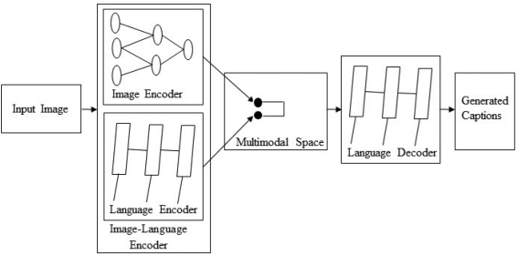
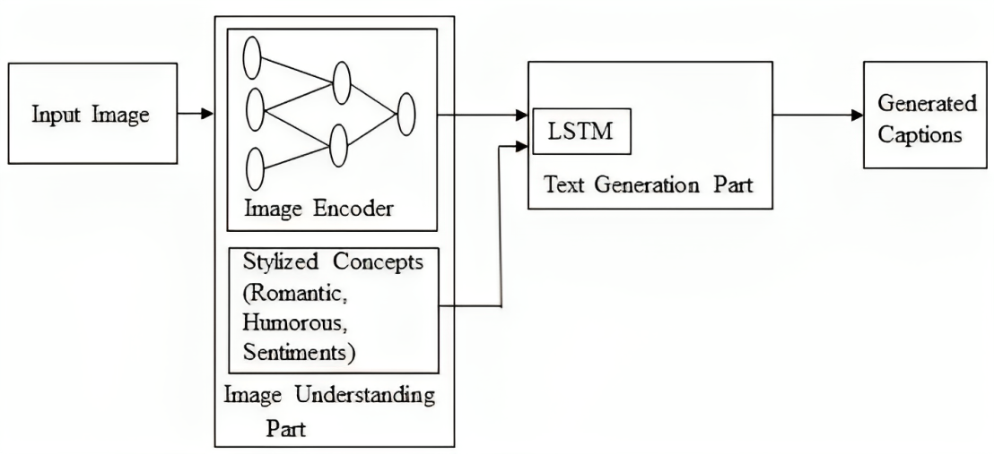
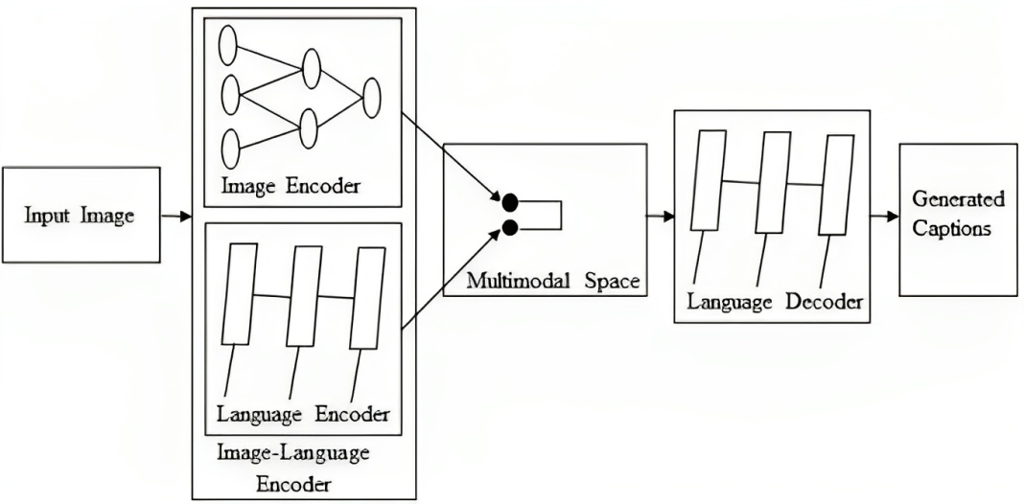
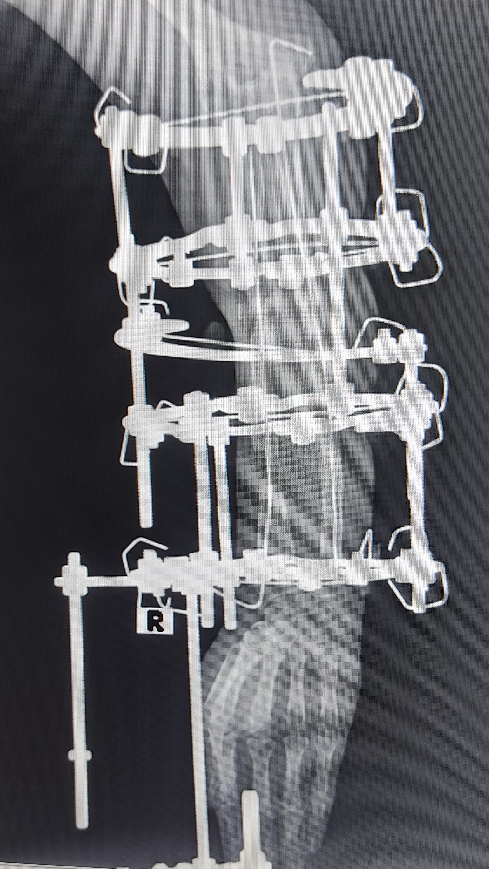
Fracture Description And Suggestion

Slide 7
Development Process
1. Data Collection and Annotation
Gathered 1012 diverse X-ray images.
Categorized into 9 different types with 331 fractures and non-fractured cases.
2. Model Selection and Training
Experimented with CNN and LSTM models for image captioning.
Fine-tuned models using doctors' suggestions and descriptions.
3. NLP Data Integration
Collaborated with medical professionals for additional descriptions.
Integrated textual data using NLP techniques.
4. Generating Descriptions and Suggestions
Combined image features and NLP data to provide comprehensive descriptions and treatment recommendations.
Ensured that users receive expert-guided insights for fracture recovery.
5. Model Validation
Evaluated performance using separate validation datasets.
Made adjustments based on validation feedback for enhanced accuracy.

Slide 8
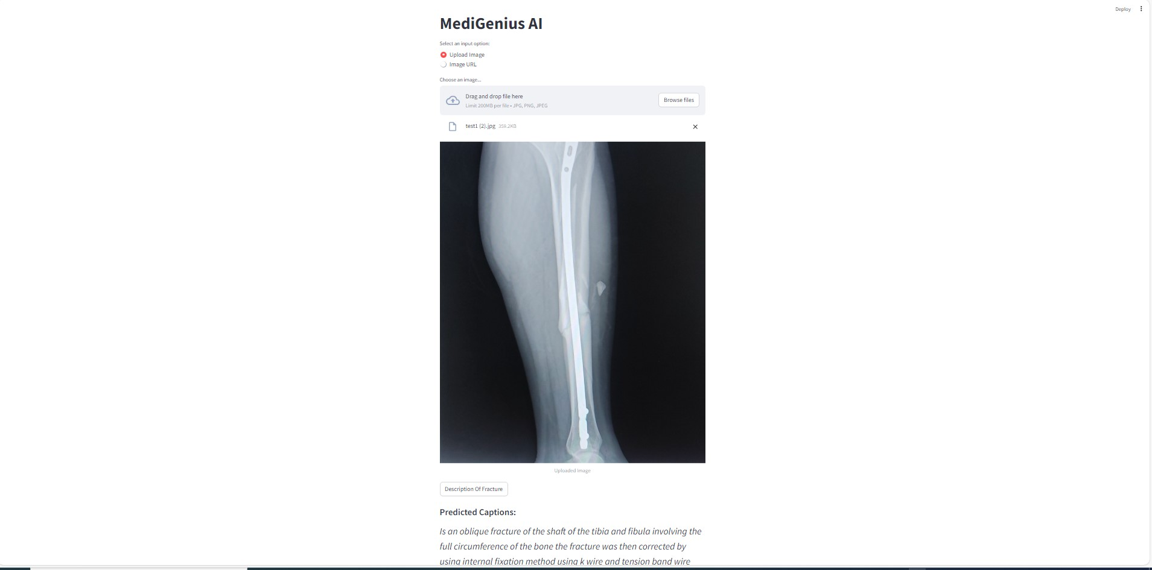
Tools & Technologies
Deep Learning Frameworks
TensorFlow
Keras
StreamLit
Development Environment
Jupyter Notebook
VsCode
Hardware Acceleration
NVIDIA RTX 3050 GPU
Deployment Using Streamlit

Slide 9

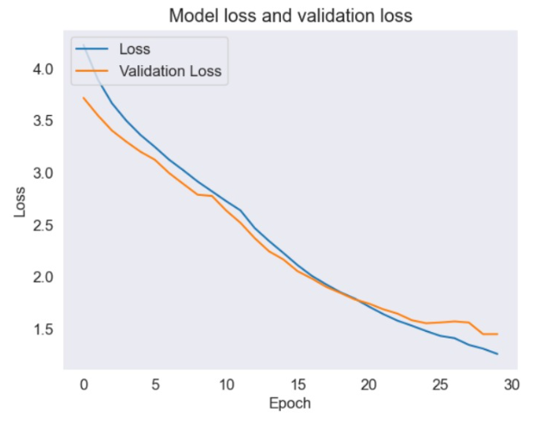
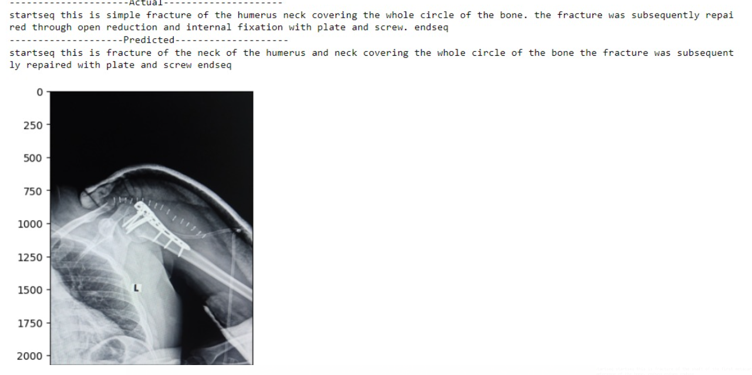
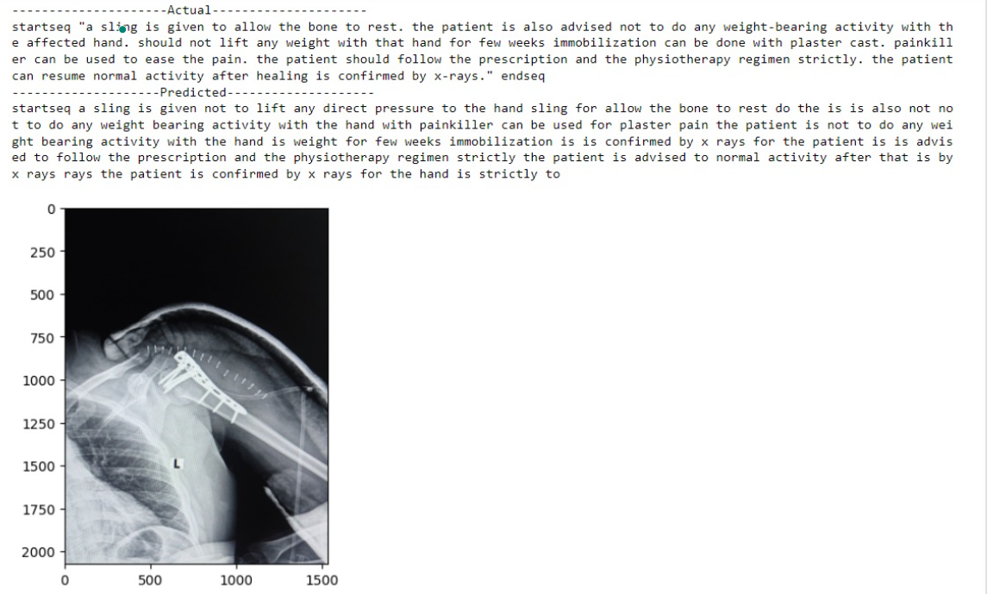
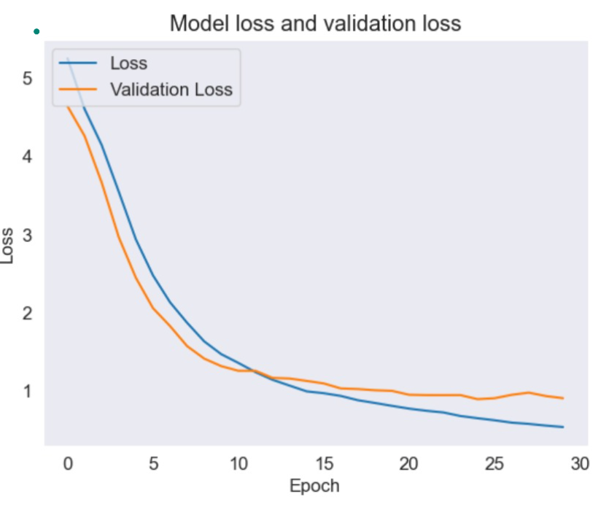
Results
Description:
Suggestion:

